Slide 1
NORTHWIND TRADERS.
~Manikanta

Slide 2
Northwind Traders – Overview.
Northwind Traders is a fictional company used for data analysis.
It deals with global import/export of specialty foods.
Operates with customers, suppliers, orders, and shipping data.

Slide 3
Dataset Introduction.
Dataset includes: Customers
Orders
Order Details
Shippers
Suppliers
Address
Employees
Categories
Used for business insights and analysis.

Slide 4
Handling errors and null values.
Error Handling
Handling Null Values
- Corrected data type mismatches
- Fixed inconsistent formats (dates, text)
- Removed duplicate records
- Removed rows with critical missing data
- Filled missing values where possible
- Used defaults for minor gaps

Slide 5
EDA – Insights.
Top Customers Identified A small group of customers contributes a large portion of total sales (high-value customers).
Sales Trend Over Time Sales show fluctuations across months, indicating possible seasonal demand patterns.
Best-Selling Products Certain products consistently generate higher sales and order volumes.
Order Volume Analysis Majority of orders contain small quantities, while a few bulk orders drive revenue.
Geographical Insights Sales are concentrated in specific countries/regions, showing strong market presence there.
Shipping Performance Some shippers handle more orders, indicating preferred logistics partners.
Delivery Time Patterns Variation between order date and ship date highlights potential delays.
Discount Impact Higher discounts tend to increase order quantity but may reduce profit margins.

Slide 6
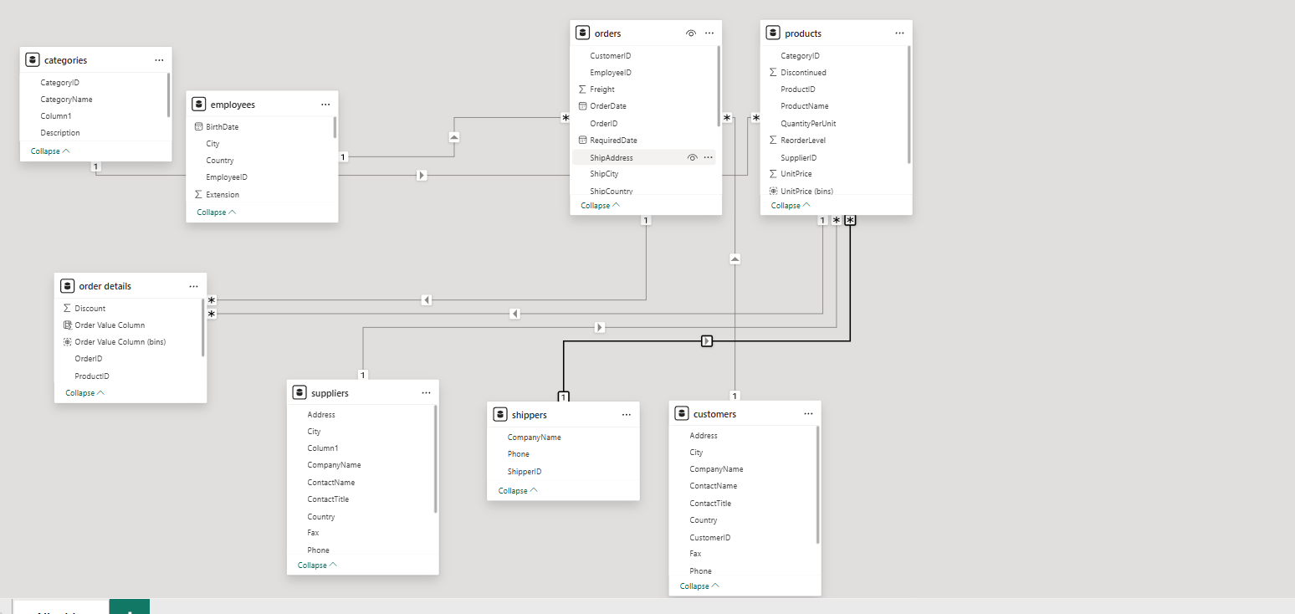
Data Model.

Slide 7
Power BI Questions.
How does customer distribution vary across different countries or cities? Use bar chart or map to visualize?
What is the trend in customer orders over time? Use line chart or area chart to visualize?
What is the distribution of customers by Contact Title or Region? Use stacked bar chart or pie chart to visualize?
How does order volume change over time? Use line chart or stacked bar chart to visualize?
What is the distribution of order values? Use histogram or box plot to visualize?
What is the average order shipping duration? Use bar chart or box plot to visualize?
What is the count of employees by job title or region? Use stacked bar chart or tree map to visualize?
What is the distribution of employee tenure? Use histogram or box plot to visualize?
What is the reporting structure among employees? Use org chart or hierarchical tree to visualize?
Which products have the highest sales volume? Use bar chart or tree map to visualize?
How does the sales volume vary across different product categories? Use stacked bar chart or tree map to visualize?
Can we visualize the pricing distribution of products? Use box plot or histogram to visualize?
How many products are supplied by each supplier? Use bar chart or pie chart to visualize?
How does product pricing vary across different suppliers? Use box plot or stacked column chart to visualize?
What is the geographical distribution of suppliers? Use map chart or bubble map to visualize?

Slide 8
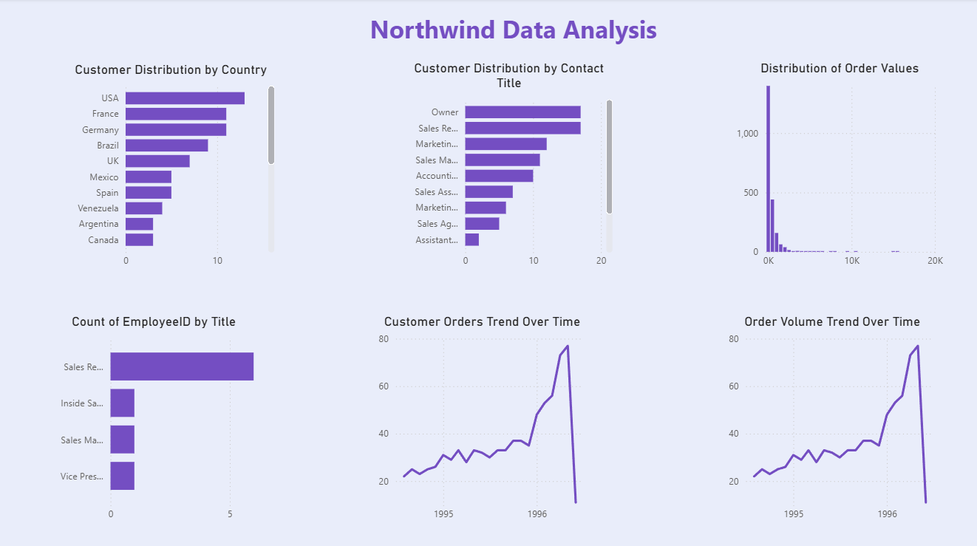

Slide 9
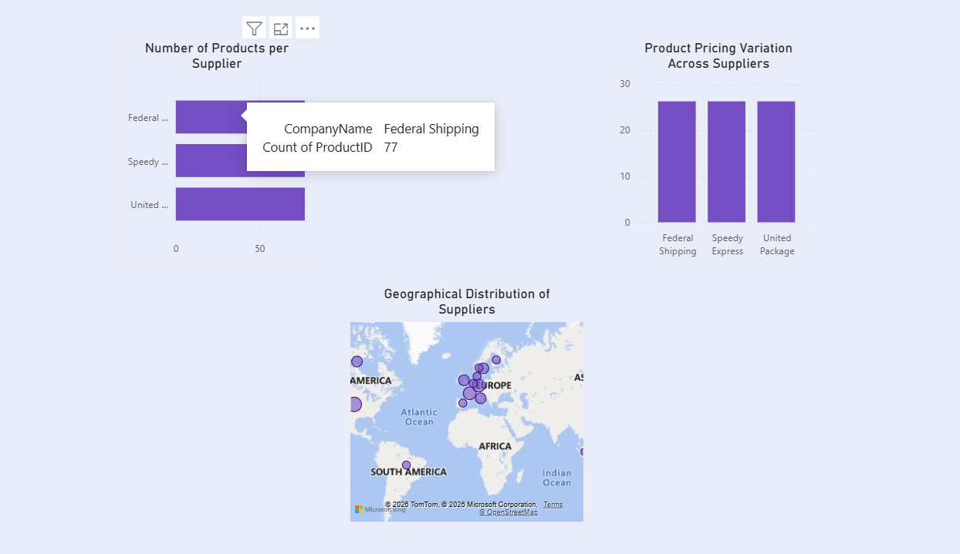

Slide 10
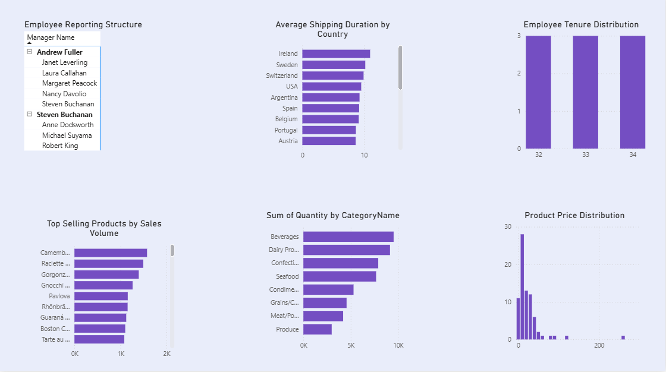

Slide 11
Summary and Suggestions.
Analyse sales performance.
Understand shipping efficiency.
Explore business trends and patterns.
Identify top customers and products.
Data analysis helps improve decision-making.
Supply chain understanding.
Northwind dataset provides insights into sales and operations.

